Slide 1
Pathogens
Do Now: LEARNING REVIEW
State 3 characteristics of living things.
Describe how a bacteria cell is different to a virus.
Give an example of an organism from the fungi kingdom.

Slide 2
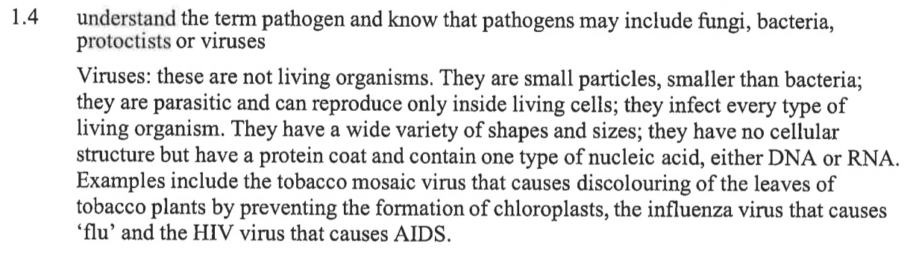
Learning Challenges

Slide 3
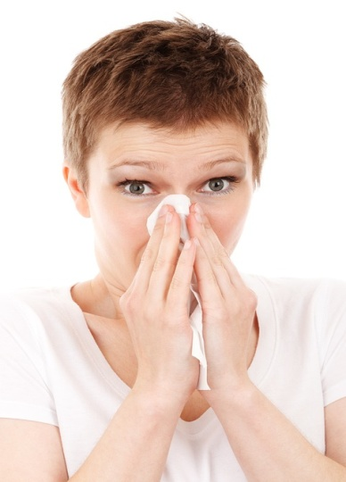
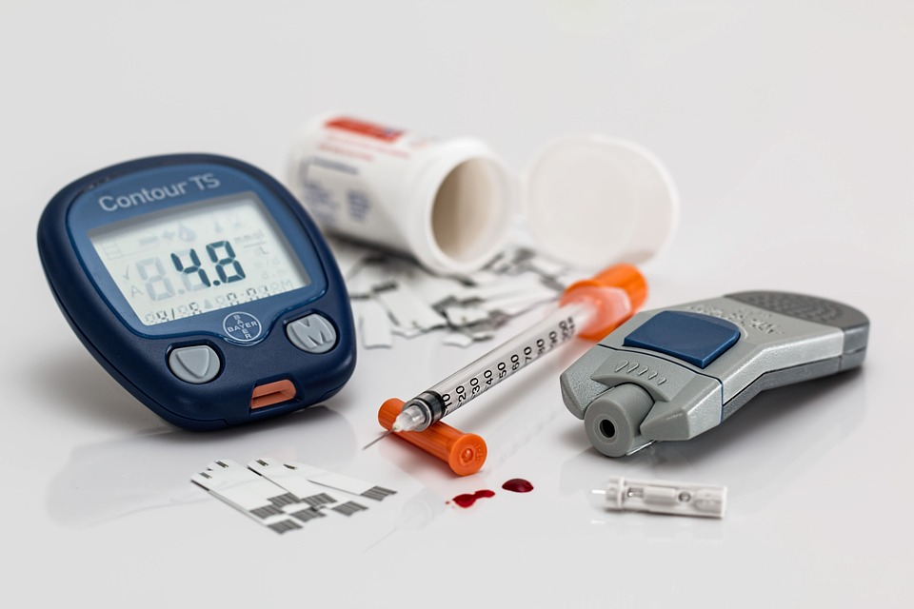
Communicable and non-communicable disease
Communicable – diseases caused by pathogens that can be spread between people
Non-communicable – diseases that develop within a person from genetic or environmental factors and cannot be spread between people

Slide 4
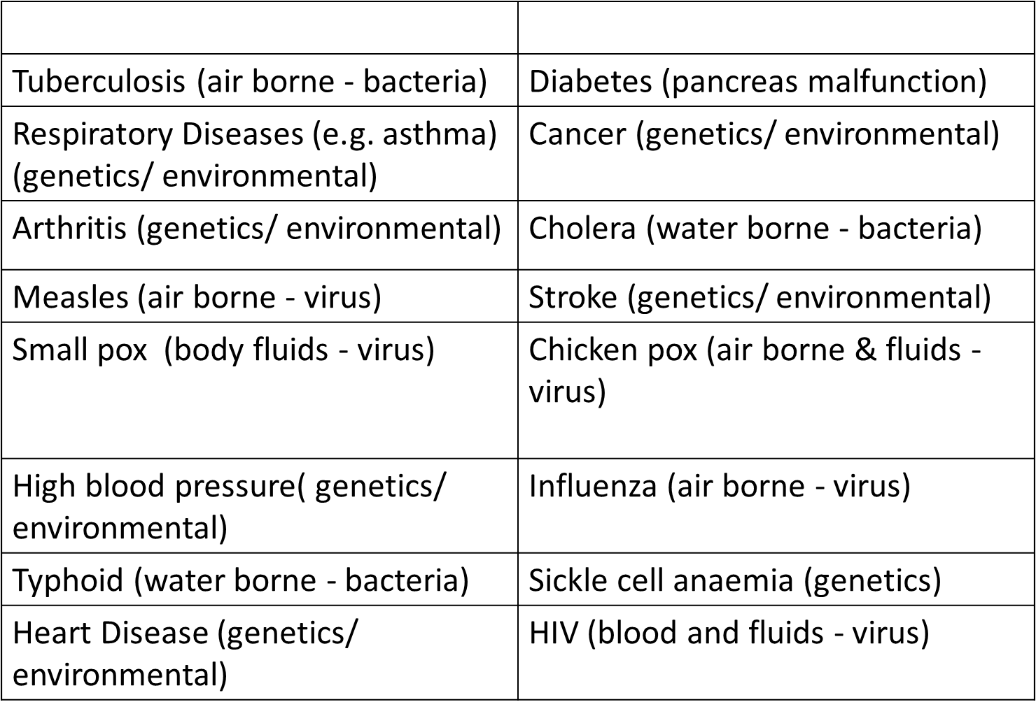
Task: Sort the different diseases into a table– is it a communicable or non-communicable disease?

Slide 5

Communicable | Non-communicable
Tuberculosis (air borne - bacteria) | Diabetes (pancreas malfunction)
HIV (blood and fluids - virus) | Cancer (genetics/ environmental)
Chicken pox (air borne & fluids - virus) | Heart Disease (genetics/ environmental)
Measles (air borne - virus) | Stroke (genetics/ environmental)
Small pox (body fluids - virus) | Respiratory Diseases (e.g. asthma) (genetics/ environmental)
Cholera (water borne - bacteria) | Arthritis (genetics/ environmental)
Typhoid (water borne - bacteria) | Sickle cell anaemia (genetics)
Influenza (air borne - virus) | High blood pressure( genetics/ environmental)
Self-assessment

Slide 6
What is a risk factor?
A risk factor is anything that may increase the chance of a harmful outcome
What are some risk factors for communicable diseases?

Slide 7
Self-assessment:
Not washing your hands
Undercooked food
Poor sanitary conditions
What are some risk factors for communicable diseases?
Dirty water
Lack of medical treatment to stop spread of infection, e.g. antibiotics & vaccines
Not covering your mouth when you cough or sneeze

Slide 8
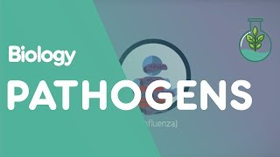
What causes communicable diseases?
https://www.youtube.com/watch?v=WsZS4RCWpcE
Notes:
https://www.youtube.com/watch?v=WsZS4RCWpcE

Slide 9
Knowledge Check
Describe how bacteria make people ill.
Give 2 examples of illnesses caused by fungi.
Describe how viruses make people ill.
Give 2 examples of illnesses caused by protists.
Explain why a virus is not a living organism.

Slide 10
Knowledge Check
Describe how bacteria make people ill.
Bacteria produce toxins when they reproduce – it is the toxins that make us ill.
Give 2 examples of illnesses caused by fungi.
Two examples of diseases caused by fungi are ringworm and athletes foot.
Describe how viruses make people ill.
Viruses enter into cells and reproduce eventually bursting the cell and spreading to others.
Give 2 examples of illnesses caused by protists.
Two examples of diseases caused by protists are amoebic dysentery and malaria.
Explain why a virus is not a living organism.
Viruses do not fulfill the criteria of living things (MRS C GREN). They are only DNA/RNA in a protein coat, can only reproduce inside host cells.

Slide 11
How are pathogens spread from person to person?
Direct contact
Indirect contact
Through water
Through the air
On food

Slide 12
Research Task
In pairs fill in the table about one of the following:
Pneumonia
Cholera
Flu
Malaria
Tobacco mosaic virus
HIV
Ringworm
Information to include:
Name
What it’s caused by (pathogen)
How is it spread?
Symptoms
Treatment

Slide 13
Fill in the table as each group presents their research.
Disease | Pathogen | How it’s spread? | Symptoms | Treatment
Flu
Pneumonia
Ringworm
Cholera
Tobacco Mosaic Virus
Malaria
HIV (AIDS)

Slide 14
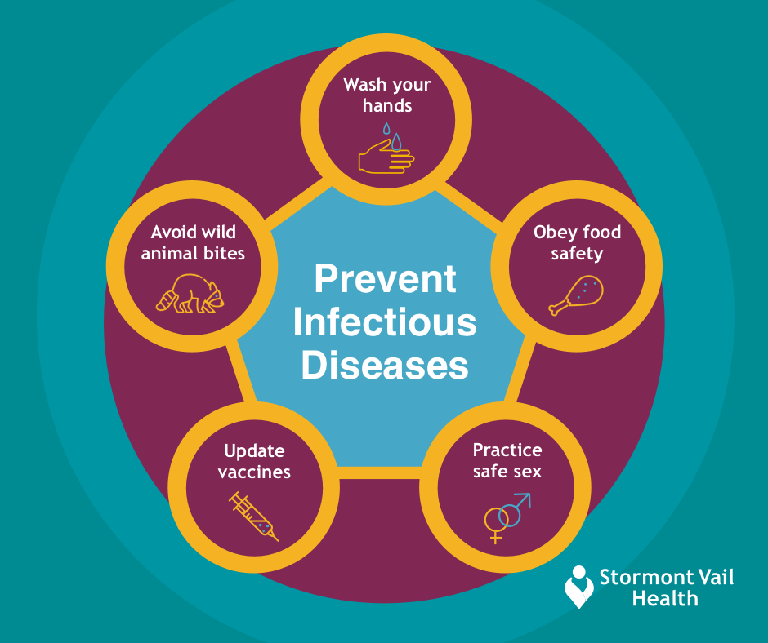
How can we prevent the spread of disease?

Slide 15
Top 10 preventable threats to health
Low weight children and mothers
Unsafe sex
High blood pressure
Tobacco
Alcohol
Unsafe water, sanitation and hygiene
High cholesterol
Indoor smoke from solid fuels
Iron deficiency
Obesity
Together, they account for 40% of the 56m deaths that occur world-wide each year

Slide 16
Plenary - Here’s the answer, what’s the question?
Pathogen
Non-communicable
Toxins
Athletes foot
Tomato Mosaic Virus

